Slide 1


RISC and CISC

Slide 2
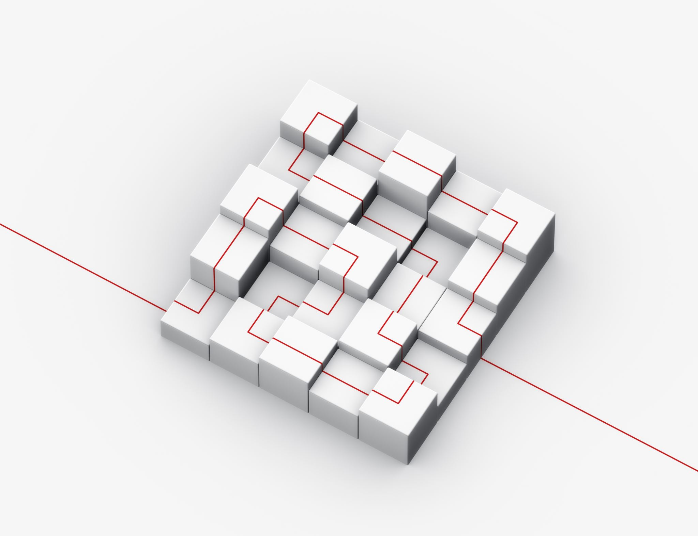
Reduced Instruction Set Architecture (RISC)
The main idea behind this is to make hardware simpler by using an instruction set composed of a few basic steps for loading, evaluating, and storing operations just like a load command will load data, a store command will store the data.

Slide 3
Complex Instruction Set Architecture (CISC)
The main idea is that a single instruction will do all loading, evaluating, and storing operations just like a multiplication command will do stuff like loading data, evaluating, and storing it, hence it’s complex

Slide 4

Focus
Both approaches try to increase the CPU performance
RISC: Reduce the cycles per instruction at the cost of the number of instructions per program.
CISC: The CISC approach attempts to minimize the number of instructions per program but at the cost of an increase in the number of cycles per instruction.

Slide 5
Characteristic of RISC
Simpler instruction, hence simple instruction decoding.
Instruction comes undersize of one word.
Instruction takes a single clock cycle to get executed.
More general-purpose registers.
Simple Addressing Modes.
Fewer Data types.
A pipeline can be achieved.

Slide 6
Characteristic of CISC
Complex instruction, hence complex instruction decoding.
Instructions are larger than one-word size.
Instruction may take more than a single clock cycle to get executed.
Less number of general-purpose registers as operations get performed in memory itself.
Complex Addressing Modes.
More Data types.

Slide 7

Example
Suppose we have to add two 8-bit numbers:
CISC approach: There will be a single command or instruction for this like ADD which will perform the task.
RISC approach: Here programmer will write the first load command to load data in registers then it will use a suitable operator and then it will store the result in the desired location.
So, add operation is divided into parts i.e. load, operate, store due to which RISC programs are longer and require more memory to get stored but require fewer transistors due to less complex command.

Slide 8
Difference
RISC | CISC
Focus on software | Focus on hardware
Uses only Hardwired control unit | Uses both hardwired and microprogrammed control unit
Transistors are used for more registers | Transistors are used for storing complex Instructions
Fixed sized instructions | Variable sized instructions
Can perform only Register to Register Arithmetic operations | Can perform REG to REG or REG to MEM or MEM to MEM
Requires more number of registers | Requires less number of registers

